Slide 1

Software Development project-1 Project Name: Tic Tac Toe Game Supervised by: Presented by: Professor Dr. Ziaur Rahman Name: Kabir Hosen Dept of ICT, MBSTU ID:it-23041 Course code: 1200 1st Year 2nd Semester Session: 2022-2023 Dept of ICT, MBSTU 1

Slide 2
Objectives 1. Introduction 2. How the Program Structured 3. Code Structure 4. Declaration of printBoard Function 5. Declaration of CheckWin Function 6. Game Flow 7. Challenges 8. Conclusion 2

Slide 3
Introduction 1. The classic Tic Tac Toe game implemented in C. 2. A two-player game where each player takes turns marking X or O on a 3x3 grid. 3. The first player to get three of their marks in a row, column, or diagonal wins. 3

Slide 4
How The Program Structured At the time when program start we initialize variables, and we run the game loop until the game end or player choose to quite the game consists of three steps: 1. Display Board 2. Get player move 3. Check for game end 4

Slide 5
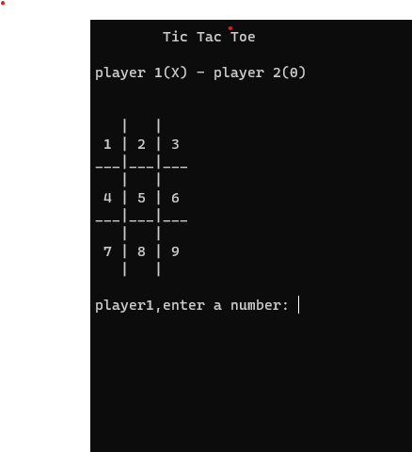
Con… this game uses board to control players. In each turns players enter a number and choose a move. Simplify programming assumes that player one always moves first and X’s. Player two moves at 2nd position and uses O’s. 5

Slide 6
7 Reasons You Should Play Tic Tac Toe 1. It’s easy to learn 2. It’s fun 3. It can be played anywhere 4. It helps improve concentration and focus 5. It can help relieve stress and anxiety 6. It increases your creativity 7. It builds relationships 6

Slide 7
Code Structure The program consists of the following function printBoard Function: Represents the Tic Tac Toe board and handles the game state. checkWin Function: checkhing the winner. 7

Slide 8
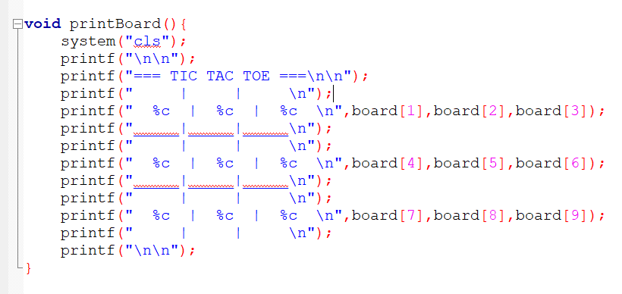
printboard Function We declare printBoard function for drawing the game board. 9

Slide 9
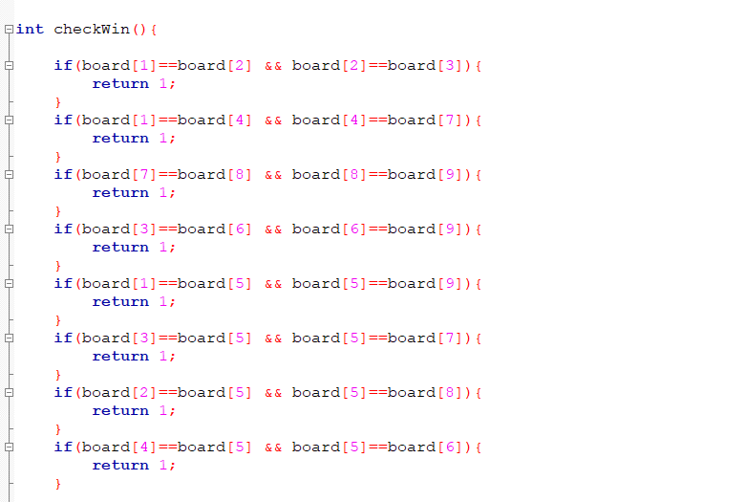
checkWin Function we declare checkWin function for checking the winner. 10

Slide 10
Game Flow 1. Display an empty Tic Tac Toe board. 2. Ask Player 1 for their move (row and column). 3. Validate the move, and if valid, mark X on the board. 4. Check for a winning condition or a draw. 5. If the game is not over, ask Player 2 for their move. 6. Repeat steps 3 to 5 until the game is over. 7. Display the result: Player 1 wins, Player 2 wins, or it's a draw. 11

Slide 11
Conclusion 1. Tic Tac Toe game in C is a fun and challenging project. 2. It helps improve coding skills and understanding of algorithms. 3. The project can be extended to implement AI-based players. 12

Slide 12
THANK YOU

